Slide 1
Minor project- ai interviewer(modgenix-1)
Presented by:
Aayush Kumar Singh
Aman Uttam
Aishwary Dongre

Slide 2
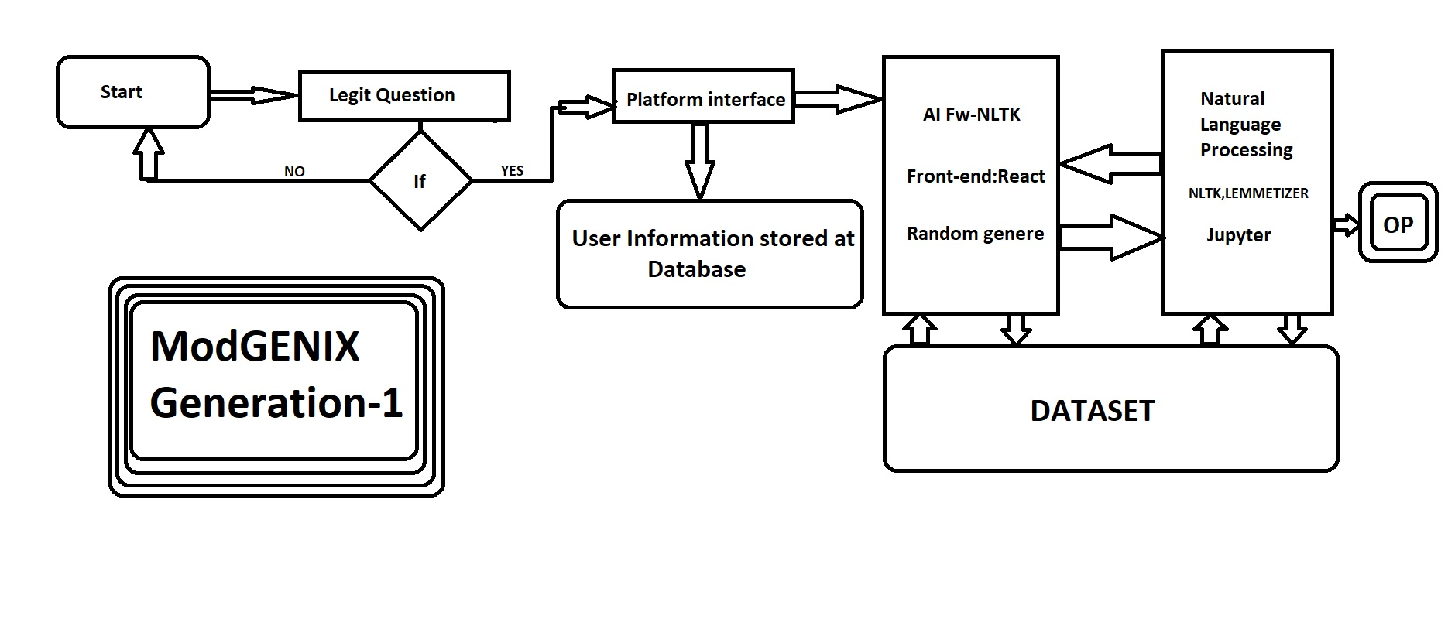

Slide 3
Natural language toolkit(NLTK)
The Natural Language Toolkit (NLTK) is a platform used for building Python programs that work with human language data for applying in statistical natural language processing (NLP).
It contains text processing libraries for tokenization, parsing, classification, stemming, tagging and semantic reasoning. It also includes graphical demonstrations and sample data sets as well as accompanied by a cook book and a book which explains the principles behind the underlying language processing tasks that NLTK supports.

Slide 4
What is scikit-learn(sklearn)???
Scikit-learn (Sklearn) is the most useful and robust library for machine learning in Python. It provides a selection of efficient tools for machine learning and statistical modeling including classification, regression, clustering and dimensionality reduction via a consistence interface in Python.
This library, which is largely written in Python, is built upon NumPy, SciPy and Matplotlib.

Slide 5
Features of scikit-learn
Some of the most popular groups of models provided by Sklearn are as follows −
Supervised Learning algorithms − Almost all the popular supervised learning algorithms, like Linear Regression, Support Vector Machine (SVM), Decision Tree etc., are the part of scikit-learn.
Unsupervised Learning algorithms − On the other hand, it also has all the popular unsupervised learning algorithms from clustering, factor analysis, PCA (Principal Component Analysis) to unsupervised neural networks.
Clustering − This model is used for grouping unlabeled data.
Cross Validation − It is used to check the accuracy of supervised models on unseen data.

Slide 6
What is NUMpy ?
NumPy is a Python library used for working with arrays. It also has functions for working in domain of linear algebra, fourier transform, and matrices.
NumPy was created in 2005 by Travis Oliphant. It is an open source project and you can use it freely .NumPy stands for Numerical Python.

Slide 7
Why Use Numpy ?
In Python we have lists that serve the purpose of arrays, but they are slow to process .NumPy aims to provide an array object that is up to 50x faster than traditional Python lists.
The array object in NumPy is called ndarray, it provides a lot of supporting functions that make working with ndarray very easy.Arrays are very frequently used in data science, where speed and resources are very important.

Slide 8
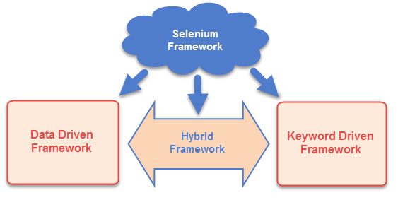
Selenium framework
The Selenium Framework is a code structure that makes code maintenance easy and efficient. Without frameworks, users may place the “code” and “data” at the same location which is neither reusable nor readable. Frameworks produce beneficial outcomes like increased code reusability, higher portability, reduced cost of script maintenance, better code readability, etc.

Slide 9
Source Code:
import io
import random
import string
import warnings
import numpy as np
from sklearn.feature_extraction.text import TfidfVectorizer
from sklearn.metrics.pairwise import cosine_similarity
import warnings
warnings.filterwarnings('ignore')

Slide 10
import nltk
from nltk.stem import WordNetLemmatizer
nltk.download('popular', quiet=True)
f=open('dataset.txt','r',errors = 'ignore')
raw=f.read()
raw = raw.lower()
from sklearn.feature_extraction.text import TfidfVectorizer
from sklearn.metrics.pairwise import cosine_similarity

Slide 11
sent_tokens = nltk.sent_tokenize(raw)
word_tokens = nltk.word_tokenize(raw)
lemmer = nltk.stem.WordNetLemmatizer()
def LemTokens(tokens):
return [lemmer.lemmatize(token) for token in tokens]
remove_punct_dict = dict((ord(punct), None) for punct in string.punctuation)
def LemNormalize(text):
return LemTokens(nltk.word_tokenize(text.lower().translate(remove_punct_dict)))

Slide 12
GREETING_INPUTS = ("hello", "hi", "greetings", "sup", "what's up","hey",)
GREETING_RESPONSES = ["hi", "hey", "*nods*", "hi there", "hello", "I am glad! You are talking to me"]
def greeting(sentence):
for word in sentence.split():
if word.lower() in GREETING_INPUTS:
return random.choice(GREETING_RESPONSES)

Slide 13
def response(user_response):
robo_response=''
sent_tokens.append(user_response)
TfidfVec = TfidfVectorizer(tokenizer=LemNormalize, stop_words='english')
tfidf = TfidfVec.fit_transform(sent_tokens)
vals = cosine_similarity(tfidf[-1], tfidf)
idx=vals.argsort()[0][-2]
flat = vals.flatten()
flat.sort()
req_tfidf = flat[-2]
if(req_tfidf==0):
robo_response=robo_response+"I am sorry! I don't understand you"
return robo_response
else:
robo_response = robo_response+sent_tokens[idx]
return robo_response

Slide 14
flag=True
print("Interviewer: My name is Interviewer. I will be interviewing you for the next 10 minutes. If you want to exit, type fireexit")
while(flag==True):
user_response = input()
user_response=user_response.lower()
if(user_response!='fireexit'):
if(user_response=='thanks' or user_response=='thank you' ):
flag=False
print("Interviewer: You are welcome..")
else:
if(greeting(user_response)!=None):
print("Interviewer: "+greeting(user_response))
else:
print("Interviewer: ",end="")
print(response(user_response))
sent_tokens.remove(user_response)
else:
flag=False
print("Interviewer: Bye! take care..")

